Slide 1



Hibernate – The session
Session
16
Chaim Turkel
Ido Barash

Slide 2


DAO using session
Exrcise
Import the developers project to eclipse.
Add a new layer of DAOs Each DAO should support:
Create
ReadByPrimaryKey
Update
Delete
Implement DeveloperDao
For now, open a new transaction per DAO method.
Wrire Junit tests to check each operation.

Slide 3
DAO using session
Exercise - solution
public interface CrudDao<T> {
public Integer create(T entity);
public T readByPrimaryKey(Integer id);
public void delete(T entity);
public T update(T entity);
} public interface DevelopersDao extends CrudDao<AbstractDeveloper> {
}
DAO interfaces

Slide 4
DAO using session
Exercise – solution @Repository
public class DevelopersHibernateDao implements DevelopersDao {
@Autowired
private SessionFactory sessionFactory;
@Override
@Transactional
public Integer create(AbstractDeveloper entity) {
return (Integer) sessionFactory.getCurrentSession().save(entity);
}
@Override
@Transactional
public AbstractDeveloper readByPrimaryKey(Integer id) {
return (AbstractDeveloper) sessionFactory.getCurrentSession() .get(AbstractDeveloper.class, id);
{
DAO implementation

Slide 5
DAO using session
Exercise - solution
@Override
@Transactional
public void delete(AbstractDeveloper entity) {
sessionFactory.getCurrentSession().delete(entity);
}
@Override
@Transactional
public AbstractDeveloper update(AbstractDeveloper entity) {
return (AbstractDeveloper) sessionFactory.getCurrentSession() .merge(entity);
{
{
DAO implementation

Slide 6
JPA Entity manager
JPA specification was generated out of Hibernate.
JPA has an easier to use API.
JPA’s entities operations are achieved via a Session equivilant object which called EntityManger.
As opposed to the Session’s many methods for doing alomost the same things, the EntityManager has just what you need.
JPA doesn’t offer support if you do need to use the Session’s both merge and update, or both save and persist

Slide 7
JPA Entity manager
JPA Entity Manager is created and retrieved from the Application server.
@PersistenceContext
private EntityManager entityManager;
JPA Entity Manager has only 3 methods for create, update and Delete:
entityManager.persist(entity);
entityManager.merge(entity);
entityManager.remove(entity);

Slide 8
JPA Entity manager
JPA offers 4 find method for easy SELECT
entityManager.find(AbstractDeveloper.class, primaryKey);
entityManager.find(entityClass, primaryKey, lockMode);
entityManager.find(entityClass, primaryKey, properties);
entityManager.find(entityClass, primaryKey, lockMode, properties);
JPA also offers easy querying API.
entityManager.createQuery(JPQL String);
entityManager.createNativeQuery(SQL String);
entityManager.createQuery(criteriaQuery);

Slide 9

Last session – Hibernate mapping
Persistency in general
Hibernate introduction
ORM
DAO design pattern
Entity mapping - Basics
Entity mapping - Relationships
Entity mapping - Inheritance

Slide 10
Hibernate’s session
Transactions introduction
Transactions using Spring
Hibernate session
DAOs using session
JPA’s EntityManager

Slide 11
Hibernate Queries
AbstractDao
create() read()
update()
delete()
UnDeletedObjectDao
override delete()
StudentDao
AddressDao
PaymentDao
RefundDao

Slide 12
Hibernate Queries
public interface AbstractDao<T> {
public void create(T object);
public T read(Integer id);
public void update(T object);
public void delete(T object);
{ public abstract class AbstractHibernatecDao<T> implements AbstractDao<T> {
public void create(T object) { //default implementation of create }
public T read(Integer id) { //default implementation of read by primary key }
public void update(T object) { //default implementation of update }
public void delete(T object) { //default implementation of delete }
{

Slide 13
Hibernate Queries
public interface StudentDao extends AbstractDao<Student> {
public Student readByName(String name);
public List<Student> loadStudentFromClass(Integer classNumber);
{
public class StudentHibernateDao extends AbstractHibernateDao<Student> implements StudentDao {
public Student readByName(String name) {}
public List<Student> loadStudentFromClass(Integer classNumber) {}
}
Student inherits basic CRUD and adds it’s own specific operations

Slide 14
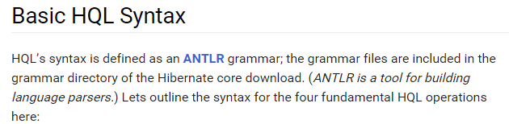




Hibernate Queries

Slide 15
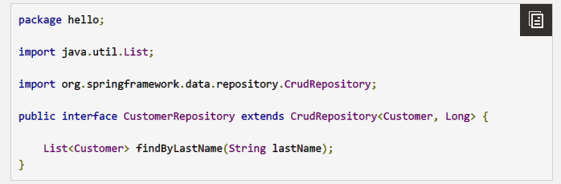
Spring Data

Slide 16
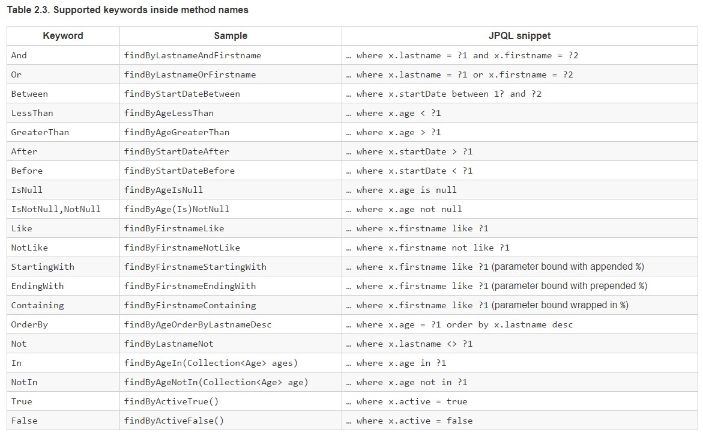
Spring Data
http://docs.spring.io/spring-data/jpa/docs/current/reference/html/

Slide 17
Transactions
Lets simulate a bank money transfer between two accounts:
Decrease sum account A
DB
Accounts
logs
Increase sum account B
Update bank’s log

Slide 18
Transactions
Lets simulate a bank money transfer between two accounts:
Decrease sum account A
DB
Accounts
logs
Increase sum account B
Update bank’s log

Slide 19
Transactions
Lets simulate a bank money transfer between two accounts:
Decrease sum account A
DB
Accounts
logs
Increase sum account B
Update bank’s log

Slide 20
Transactions
Lets simulate a bank money transfer between two accounts:
Decrease sum account A
DB
Accounts
logs
Increase sum account B
Update bank’s log

Slide 21
Transactions
What if second update fails!
Decrease sum account A
DB
Accounts
logs
Increase sum account B
Update bank’s log

Slide 22
Transactions
What if second updating fails!
Decrease sum account A
DB
Accounts
logs
Increase sum account B
Failed
Update bank’s log

Slide 23
Transactions
What if second updating fails!
Account A will have less money that account B did not get.
Decrease sum account A
DB
Accounts
logs
Increase sum account B
Failed
Update bank’s log

Slide 24
Transactions
We would like to insure that if one update operations fails – all fails
If one update fails – all changes should not be committed to the DB.

Slide 25
Transactions
We would like to insure that if one update operations fails – all fails
If one update fails – all changes should not be committed to the DB.
Decrease sum account A
DB
Accounts
logs
Increase sum account B
Update bank’s log

Slide 26
Transactions
We would like to insure that if one update operations fails – all fails
If one update fails – all changes should not be committed to the DB.
Decrease sum account A
DB
Accounts
logs
Increase sum account B
Update bank’s log
Cancel

Slide 27
Transactions
We would like to insure that if one update operations fails – all fails
If one update fails – all changes should not be committed to the DB.
Decrease sum account A
DB
Accounts
logs
Revert
Increase sum account B
Update bank’s log
Cancel

Slide 28
Transactions
We would like to wrap a bunch of DB operations and reference them as a one atomic operation.
This atomic operation is called: a transaction.

Slide 29
Transactions
We would like to wrap a bunch of DB operations and reference them as a one atomic operation.
This atomic operation is called: a transaction.
A transaction can end in one of two ways:
Commit
Rollback

Slide 30
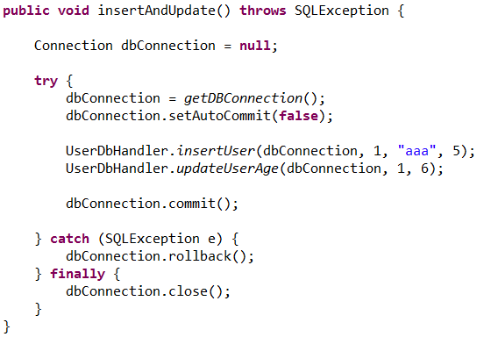
Transactions
Example of simple JDBC transaction code:

Slide 31
Transactions
Example of simple JDBC transaction code:
Disable auto-commit

Slide 32
Transactions
Example of simple JDBC transaction code:
Roll back if fails

Slide 33
Transactions
JEE environment provide us with the JTA specification.
JTA – Java Transactions API.
JTA provide us with an easy way to tell the Application Server which methods should be wrapped within a transactions.
JTA also let the Application server handle connections, roll back, etc..

Slide 34
Transactions
JEE environment provide us with the JTA specification.
JTA – Java Transactions API.
JTA provide us with an easy way to tell the Application Server which methods should be wrapped within a transactions.
JTA also let the Application server handle connections, roll back, etc..
Spring has it’s own solution.

Slide 35
Transactions using spring
Spring can perform transactions handling for us.
We need to import the spring-transactions and spring JDBC JARs

Slide 36
Transactions using spring
Spring can perform transactions handling for us.
We need to import the spring-transactions and spring JDBC JARs
<dependency>
<groupId>org.springframework</groupId>
<artifactId>spring-jdbc</artifactId>
<version>3.2.6.RELEASE</version>
</dependency>
<dependency>
<groupId>org.springframework</groupId>
<artifactId>spring-tx</artifactId>
<version>3.2.6.RELEASE</version>
</dependency>

Slide 37
Transactions using spring
Spring can perform transactions handling for us.
We need to import the spring-transactions and spring JDBC JARs
<dependency>
<groupId>org.springframework</groupId>
<artifactId>spring-jdbc</artifactId>
<version>3.2.6.RELEASE</version>
</dependency>
<dependency>
<groupId>org.springframework</groupId>
<artifactId>spring-tx</artifactId>
<version>3.2.6.RELEASE</version>
</dependency>
With some configurations, Spring will use it’s AOP mechanism to wrap methods with transactions.

Slide 38
Transactions using spring
We can configure spring to open transactions in two ways:

Slide 39
Transactions using spring
We can configure spring to open transactions in two ways:
Normal general AOP:
<tx:advice id="txAdvice" transaction-manager="transactionManager“ />
<aop:config>
<aop:pointcut id="allServices“ expression="execution(public * com.training.services.*.*(..))“/>
<aop:advisor advice-ref="txAdvice" pointcut-ref="allServices" />
</aop:config>

Slide 40
Transactions using spring
We can configure spring to open transactions in two ways:
Normal general AOP:
<tx:advice id="txAdvice" transaction-manager="transactionManager“ />
<aop:config>
<aop:pointcut id="allServices“ expression="execution(public * com.training.services.*.*(..))“/>
<aop:advisor advice-ref="txAdvice" pointcut-ref="allServices" />
</aop:config>
Annotations on methods:
<tx:annotation-driven transaction-manager="transactionManager" /> @Transactional
public void create(Object obj) {

Slide 41
Transactions using spring
This is still Spring AOP – we have the same limitation:
Spring will not open transaction if the method was not referenced using the generated proxy.
We can add limitations of our own on transactions such as:
Read – only
Nest with new transactions
etc…

Slide 42
Hibernate Session
The session is our interface with the DB.
A session is used to get physical connection to the DB.
Persistent object are saved and retrieved through the session object.
Usually, a transaction will cause new session generation. At the end of the transaction the session will be closed.
Sessions are created using SessionFactory class.

Slide 43
Hibernate Session
Session are created using Hibernate’s SessionFactory class. @Autowired
private SessionFactory sessionFactory;
public void create(Movie movie) {
sessionFactory.getCurrnetSession().save(movie);
}

Slide 44
Hibernate Session
Session are created using Hibernate’s SessionFactory class. @Autowired
private SessionFactory sessionFactory;
public void create(Movie movie) {
sessionFactory.getCurrentSession().save(movie);
}
Transaction: Session session = sessionFactory.openSession();
Transaction tx = null;
try {
tx = session.beginTransaction();
...
tx.commit();
catch (Exception e) {
if (tx!=null) {tx.rollback()};
{
finally {
session.close();
{

Slide 45
Hibernate Session
Session are created using Hibernate’s SessionFactory class. @Autowired
private SessionFactory sessionFactory;
public void create(Movie movie) {
sessionFactory.getCurrentSession().save(movie);
}
Transaction: Session session = sessionFactory.openSession();
Transaction tx = null;
try {
tx = session.beginTransaction();
...
tx.commit();
catch (Exception e) {
if (tx!=null) {tx.rollback()};
{
finally {
session.close();
{
By using Spring transactions This is done for us by spring. We only write logic code

Slide 46
Hibernate Session
Session are created using Hibernate’s SessionFactory class. @Autowired
private SessionFactory sessionFactory;
public void create(Movie movie) {
sessionFactory.getCurrentSession().save(movie);
}
Transaction: Session session = sessionFactory.openSession();
Transaction tx = null;
try {
tx = session.beginTransaction();
...
tx.commit();
catch (Exception e) {
if (tx!=null) {tx.rollback()};
{
finally {
session.close();
{
By using Spring transactions This is done for us by spring. We only write logic code

Slide 47
Hibernate Session
The main function of the session is to offer CRUD operations for instances of mapped entity classes.
Instances may exist in one of the following states:
Transient: New instance of a persistent class which is not associated with a session. It is mapped to nothing in the DB and has no identifier.
Persistent: An instance that is associated with a session. It is mapped to data in the DB and has Identifier.
Detached: An instance that was associated with a session but not now (Session was closed or cleared).

Slide 48
Hibernate Session
The instance’s state changes:

Slide 49
Hibernate Session
The instance’s state changes:
Flow:
Flow Start
Session Association
Session Close
Flow End

Slide 50
Hibernate Session
The instance’s state changes:
New instance:
Transient
Entity instance
Flow Start
Session Association
Session Close
Flow End

Slide 51
Hibernate Session
The instance’s state changes:
Instance persisted (associated with the session)
Transient
Persistent
Entity instance
Entity instance
Flow Start
Session Association
Session Close
Flow End

Slide 52
Hibernate Session
The instance’s state changes:
Logics, changes and updates until session is closed. The instance becomes “Detached”.
Transient
Persistent
Detached
Entity instance
Entity instance
Entity instance
Flow Start
Session Association
Session Close
Flow End

Slide 53
Hibernate Session
The instance’s state changes:
Flow ends or the instance associated with a session again.
Transient
Persistent
Detached
Entity instance
Entity instance
Entity instance
Flow Start
Session Association
Session Close
Flow End

Slide 54
Hibernate Session
During a transaction, we use the session to perform manipulations on our entities. We change value, add or remove objects from lists, etc..
All the changes of persistent entities occur in the Session only.
Hibernate will decide on it’s own when to flush the data to the DB.
Flush can occur at the end of the transaction or several times depend on the operations.
Commit will occur only at the end of a transaction (if succeeded).

Slide 55
Hibernate Session
Sessions are not transactions !!!
Transactions are associated with sessions.
We can use one session to create and commit several transactions (one transaction at a time - not parallel).
We use these methods to get or create the associated transaction:
session.beginTransaction();
session.getTransaction();

Slide 56
Hibernate Session
Create
In order to make a transient instance persistent we use: session.persist(object);
Persist will associate an instance of a mapped entity with the session and will change it’s state to ‘persistent’
Persist doesn’t guarantee that the object will be inserted to the DB immediately.
Persist doesn’t return the identifier (Because it might not exist till flush time).
Persist won’t generate an INSERT INTO outside of a transaction.

Slide 57
Hibernate Session
Create
In order immediately save a new instance: session.save(object);
Save returns the Identifier immediately
If the identifier is managed by the DB itself, an ISNERT INTO will occur.
Save does not require a transaction.

Slide 58
Hibernate Session
Read by ID
In order to get an instance: session.get(Class<?>, Serializable id);
Get will always hit the DB for the real instance.
If object not found – null will be returned.

Slide 59
Hibernate Session
Read by ID
In order to get an instance: session.load(Class<?>, Serializable id);
Load returns a proxy without hitting the DB.
The proxy contains the identifier value with uninitialized properties.
A SELECT query will hit the DB on a property get.
Load throws an ObjectNotFoundException if nothing found.

Slide 60
Hibernate Session
Delete
In order to delete an instance: session.delete(Object object);
Delete the instance from the DB with the given object id.
The object can be both Transient or persistent.

Slide 61
Hibernate Session
Update The update is a bit tricky since it has the most options.
If a persistent entity is manipulated within a session or a transaction, update will happen automatically when the session is flushed.
In order to persist a detached object, Hibernate provide us methods:
Update
merge

Slide 62
Hibernate Session
Update
session.update(Object object);
Make a detached instance persistent.
If object has an instance in the session, an exception will be thrown. Hibernate tells us that there are already changes for this entity (one in the session, the other is detached).

Slide 63
Hibernate Session
Update
session.merge(Object object);
If there is a persistent instance with the same id in the current session, merge will copy the state of the given instance onto the persistent one.
Incase there is no persistent instance in the session, the DB will be hit in order to fetch it. If nothing found, a new instance will be created (copied from the given) and persisted
The given instance does not become associated with the session.
The persistent instance is returned.

Slide 64
Hibernate Session
Save or Update
session.saveOrUpdate(Object object);
In case we don’t know if we should generate an INSERT INTO or an UPDATE query, we can use this method.
It will process the state of the given object and will decide what to do.
This might be expensive.

Slide 65
Hibernate Session
Extra operations
Detach persistent entity/entities: session.evict(entity);
session.clear();
Close session and clean up:
session.close();
Queries execution:
session.createQuery( HQL query ); session.createSQLQuery( SQL query );
session.createCriteria(Class<?> entity);

Slide 66
Overview - Hibernate’s session
Transactions introduction
Transactions using Spring
Hibernate session
DAOs using session
JPA’s EntityManager

Slide 67
Next session – Query API
Hibernate Query Language (HQL)
Filters and Where conditions
Run-time queries
Named queries
Criteria API

Slide 68

THANK YOU
Chaim Turkel
Email: chaim@tikalk.com

